Slide 1
Project Assignment Part 2
System Identification
2022-2023
Professor:
Bușoniu Lucian
Students:
Oprea Sergiu-Daniel
Radu Victor-Daniel
Ștefănuți Mihai
Group 30332
Index of datafile: 1/10

Slide 2
Contents
Introduction ……………………………………………………………………. 3
Approaching the problem …………………………………………….. 4
Interpretation of the results ………………………………………….. 6
Graphs for best MSEs ……………………………………………………. 8
Discussion of the results ………………………………………………. 13
Conclusion …………………………………………………………………….. 14

Slide 3
Introduction
This slideshow contains the second part of the System Identification Project.
The project consists of the creation of a nonlinear polynomial ARX model.
The degree m and the orders na and nb (na = nb) are set by the user, and the delay nk is equal to 1.
The model provides both the one-step-ahead prediction and the simulation.
The source code was written in MATLAB R2021b.

Slide 4
Approaching the problem
Generating the prediction for identification output (generate phi matrix, parameter vector theta, resulting output, compute MSE).
Generating the prediction for validation output (generate phi matrix, resulting output, compute MSE).
Generating the simulation for identification output (initialize resulting output as empty, then use to generate phi matrix and update itself, compute MSE).
Generating the simulation for validation output (initialize resulting output as empty, then use to generate phi matrix and update itself, compute MSE).

Slide 5
Approaching the problem - implementation
For prediction, phi matrix is generated by calling a function once that generates all of its delayed inputs and outputs and combinations of this terms respectively.
Identifying the prediction output using linear regression procedure.
For simulation, phi matrix is generated one row at a time by iteratively calling a function with different parameters, due to the fact that the simulation output is generated based on previous values of the model.

Slide 6
Interpretation of the results
Degree m | Orders na and nb | MSE for prediction for identification data | MSE for prediction for validation data | MSE for simulation for identification data | MSE for simulation for validation data
1 | 1 | 6.6338e-06 | 3.6412e-06 | 0.39373e-03 | 0.21011e-03
1 | 2 | 5.6052e-06 | 3.1888e-06 | 0.56013e-03 | 0.40355e-03
1 | 3 | 5.5831e-06 | 3.161e-06 | 0.55309e-03 | 0.40387e-03
1 | 4 | 5.5751e-06 | 3.1609e-06 | 0.53031e-03 | 0.3826e-03
1 | 5 | 5.562e-06 | 3.1557e-06 | 0.51347e-03 | 0.36466e-03
2 | 1 | 9.0855e-07 | 7.0993e-07 | 1.2468e-05 | 6.4266e-06
2 | 2 | 6.425e-09 | 9.2914e-07 | 8.3379e-07 | NaN

Slide 7
Interpretation of the results
Degree m | Orders na and nb | MSE for prediction for identification data | MSE for prediction for validation data | MSE for simulation for identification data | MSE for simulation for validation data
2 | 3 | 6.6653e-10 | 2.9765e-06 | 1.3246e-07 | NaN
2 | 4 | 4.9924e-10 | 7.8556e-06 | 3.4038e-07 | NaN
2 | 5 | 3.8156e-10 | 3.5925e-05 | NaN | NaN
3 | 1 | 8.5355e-07 | 6.9317e-07 | 1.0686e-05 | 5.3739e-06
3 | 2 | 2.346e-10 | 3.422e-06 | 1.2928e-08 | 5.9045e-07
3 | 3 | 1.8269e-10 | 5.1359e-05 | 2.3147e-08 | NaN
3 | 4 | 1.4352e-10 | 4.4137e-05 | 1.6565e-08 | NaN
3 | 5 | 1.2784e-10 | 2.0667e-05 | 1.0188e-08 | NaN

Slide 8
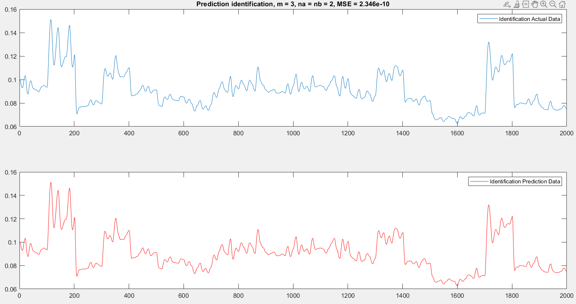
Graphs for best MSEs - prediction for identification data

Slide 9
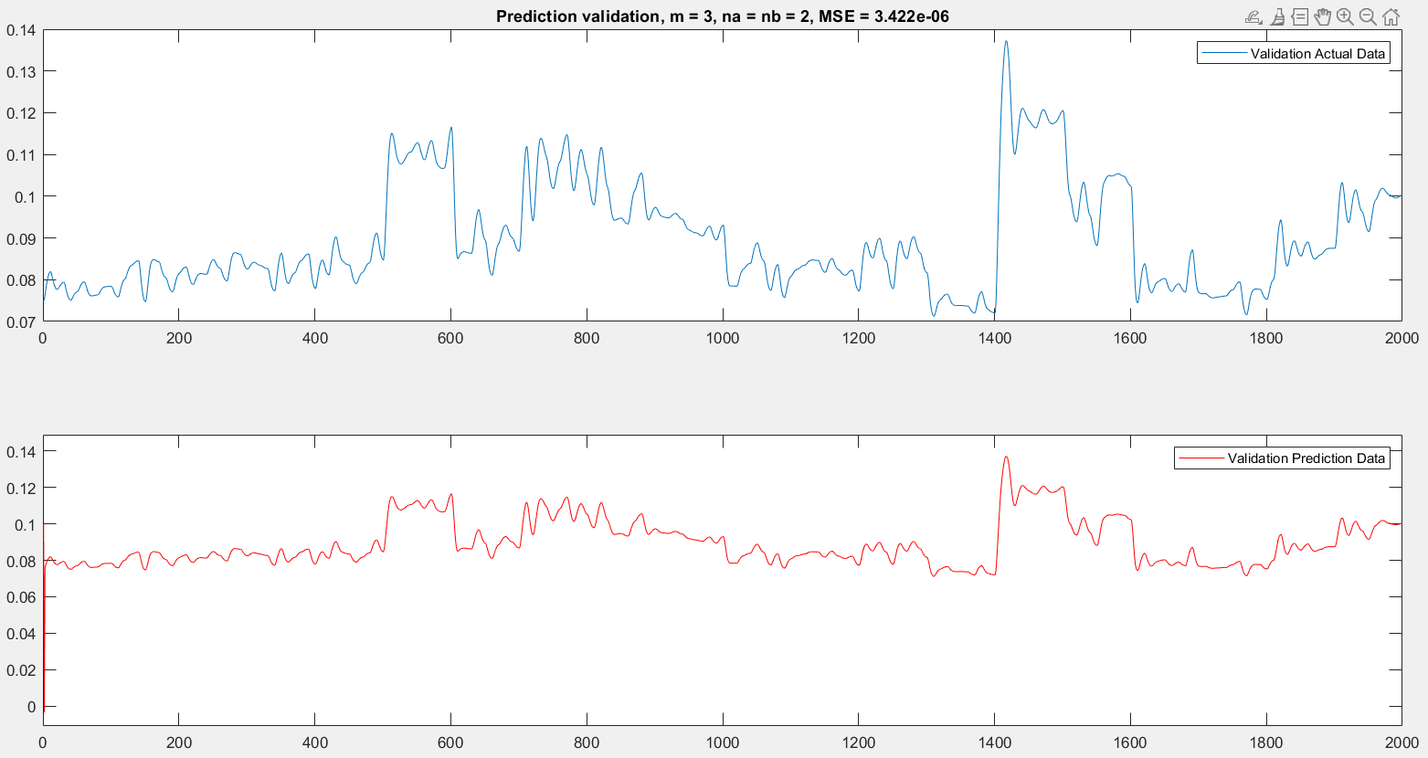
Graphs for best MSEs - prediction for validation data

Slide 10
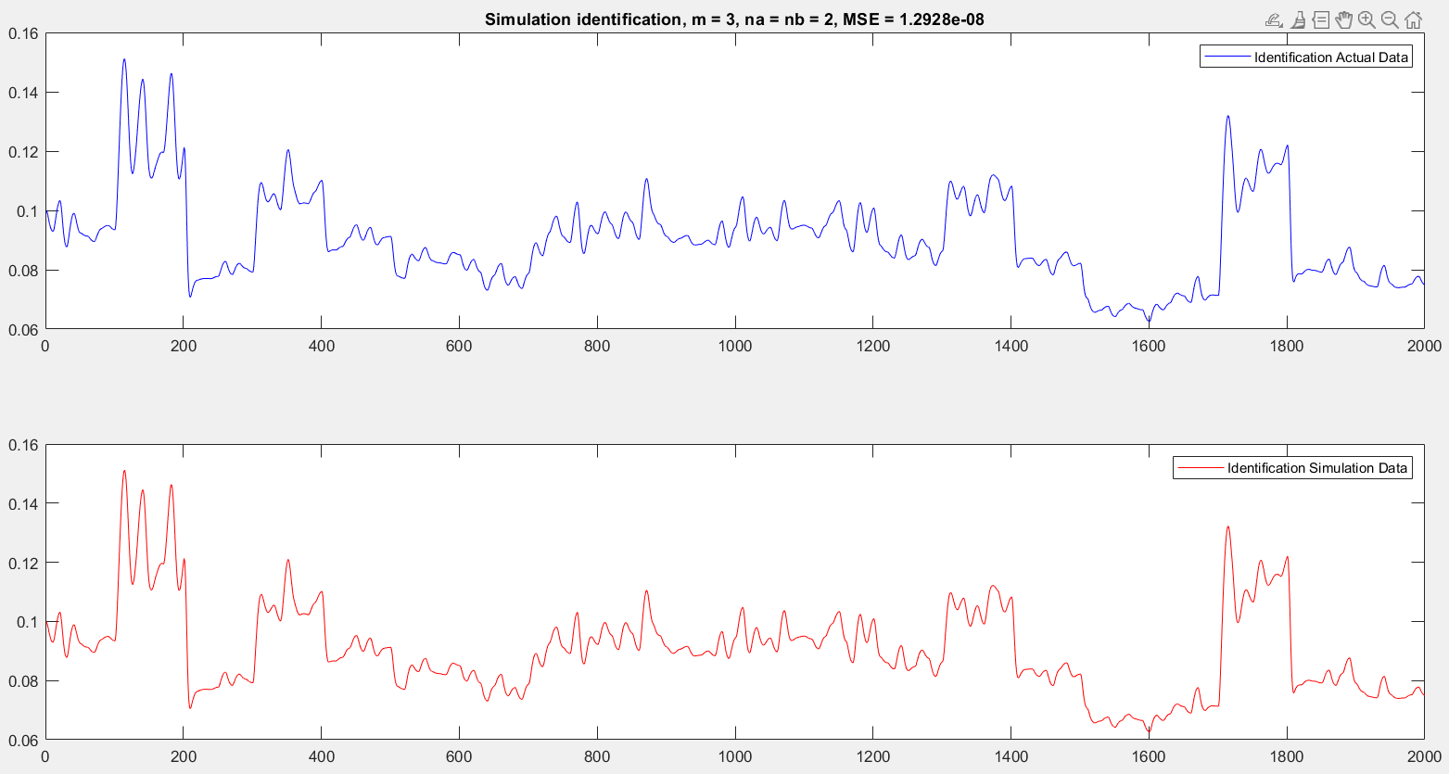
Graphs for best MSEs - simulation for identification data

Slide 11
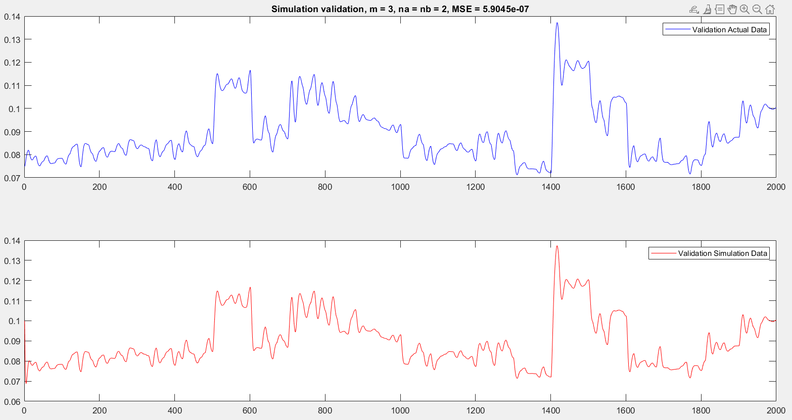
Graphs for best MSEs - simulation for validation data

Slide 12
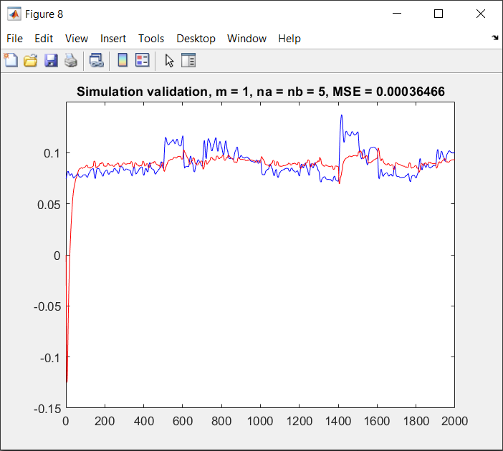
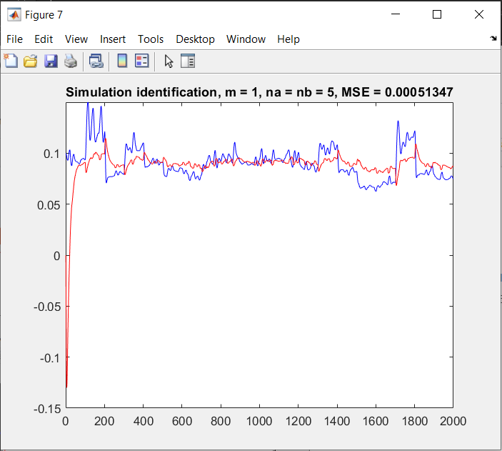
Underfitted results
They are obtained for m=1, due to the fact that there are not enough input data and the model is unable to capture the relationship between the input and the output variables in an accurate way.

Slide 13
Discussion of the results
It is observed that the best model (the one with the smallest MSEs) is the one having the degree m equal to 3 and the orders na and nb equal to 2.
Increasing the values of m and na and nb results in a better model fit with smaller errors.
For m=2 and m=3, if na ≥ m the instability phenomenon occurs in the simulation for the validation data.

Slide 14
Conclusion
The best results are obtained for m equal to 3 and na and nb equal to 2.
In conclusion, a nonlinear ARX model can be identified accurately, provided the correct values for the degree and the orders of it are given.
The obtained ARX model can be used as a black-box model for any dynamic SISO system.

